Slide 1
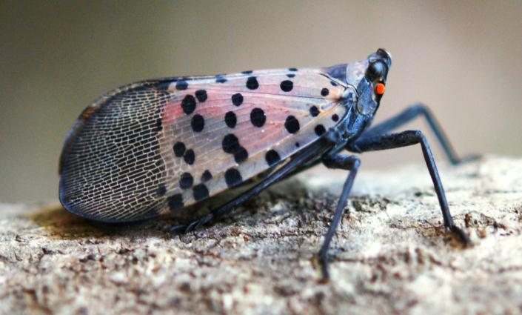
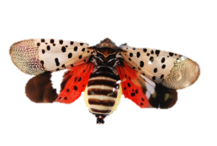
EGG MASS IDENTIFICATION FOR SPOTTED LANTERNFLY
HEMIPTERA: FULGORIDAE: Lycorma delicatula (WHITE)

Slide 2
EGG MASS IDENTIFICATION FOR SPOTTED LANTERNFLY
HEMIPTERA: FULGORIDAE: Lycorma delicatula (WHITE)
This guide will help you recognize the egg mass of the Spotted Lanternfly (Lycorma delicatula).
It will also help to distinguish between these and other common egg masses you might encounter.
Special attention will be paid to the Spotted Lanternfly’s egg shape.

Slide 3
EGG MASS IDENTIFICATION FOR SPOTTED LANTERNFLY
HEMIPTERA: FULGORIDAE: Lycorma delicatula (WHITE)
In the photo to the left you can see:
Covered Egg Mass
Adult Spotted Lanternfly
Uncovered Egg Mass

Slide 4
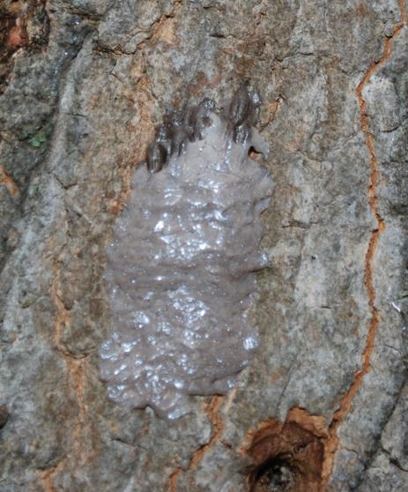
EGG MASS IDENTIFICATION FOR SPOTTED LANTERNFLY
HEMIPTERA: FULGORIDAE: Lycorma delicatula (WHITE)
Here is an example of an unfinished egg mass.
Note: You can see seed-like eggs in loose columns poking out the top.
The Spotted Lanternfly lays columns of eggs side by side. There can be as many as 30 to 50 eggs per mass. The eggs are then covered in a grey putty-like covering.
The covering is slightly tacky and will wear away over the course of the year.

Slide 5
EGG MASS IDENTIFICATION FOR SPOTTED LANTERNFLY
HEMIPTERA: FULGORIDAE: Lycorma delicatula (WHITE)
This is an egg mass from the previous season. You can see that the Spotted Lanternfly will lay several vertical rows of eggs.
The grey putty like covering you see on fresh egg masses is missing. A few eggs are also missing.
The overall length of an egg mass is about 1 inch.

Slide 6
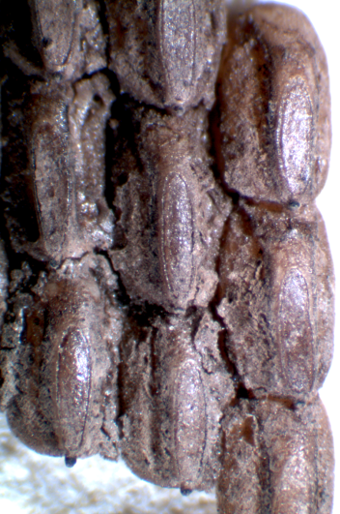
EGG MASS IDENTIFICATION FOR SPOTTED LANTERNFLY
HEMIPTERA: FULGORIDAE: Lycorma delicatula (WHITE)
The individual eggs have morphological distinctive features.
The overall appearance is a small ovoid seed with a rounded side and flattened front.
The flattened front is made up of an elongate oval disc. At one tip is a stem-like structure that extends out from the egg.
The sides of the egg, when viewed from the front, are also sunken in. This gives a pinched look to the egg.

Slide 7
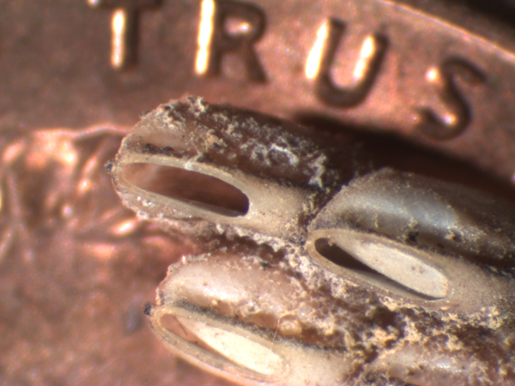
EGG MASS IDENTIFICATION FOR SPOTTED LANTERNFLY
HEMIPTERA: FULGORIDAE: Lycorma delicatula (WHITE)
Older egg masses will have the flattened disc either partially or completely removed.
In the photo to the left, you can see the size of each individual egg compared to a penny.

Slide 8
EGG MASS IDENTIFICATION FOR SPOTTED LANTERNFLY
HEMIPTERA: FULGORIDAE: Lycorma delicatula (WHITE)
Egg masses can also be parasitized by other insects.
The photo on the left is normal hatched egg (note the oval opening).
The other egg mass has circular holes in several of the eggs. These SLF were killed by parasitoids before they could hatch.

Slide 9
EGG MASS IDENTIFICATION FOR SPOTTED LANTERNFLY
HEMIPTERA: FULGORIDAE: Lycorma delicatula (WHITE)
Parasitized eggs may prove to be a source of beneficial insects in controlling the Spotted Lanternfly.
Contact Liu Houping with DCNR at hliu@pa.gov if you suspect you have parasitized egg masses. If possible, include a picture of the parasitized eggs.

Slide 10
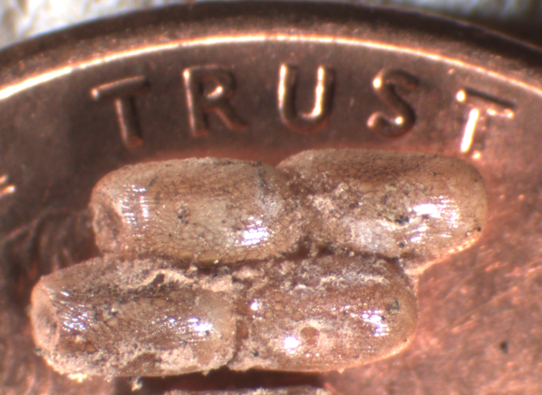
EGG MASS IDENTIFICATION FOR SPOTTED LANTERNFLY
HEMIPTERA: FULGORIDAE: Lycorma delicatula (WHITE)
In the photo to the left, you will notice the opposite side of a freshly harvested egg mass.
One egg can cover 2 letters on the word “TRUST” on a penny.

Slide 11
EGG MASS IDENTIFICATION FOR SPOTTED LANTERNFLY
HEMIPTERA: FULGORIDAE: Lycorma delicatula (WHITE)
The eggs mass putty can also dry out or become distorted before eggs hatch. The covering then takes on a dried, cracked earth appearance as seen below.
A tire track pattern can also be seen when eggs are scraped from the surface. Both of the egg masses on the stone pictured are from this year and only 2-3 weeks old.

Slide 12
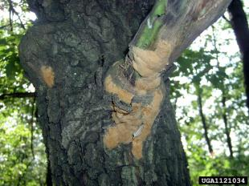
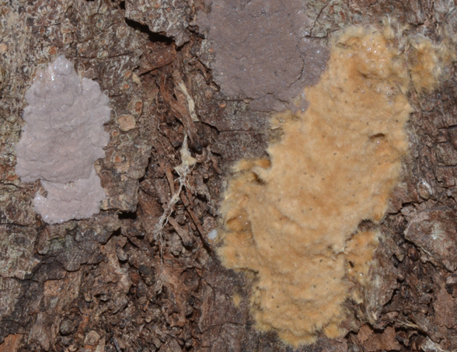
EGG MASS IDENTIFICATION FOR SPOTTED LANTERNFLY
HEMIPTERA: FULGORIDAE: Lycorma delicatula (WHITE)
Gypsy Moth’s egg masses have a similar appearance to Spotted Lanternfly.
Many of the same surfaces are used by both species.
The covering for Gypsy Moth is more fibrous and generally tanner in color.
Gypsy moth eggs are more spherical than Spotted Lanternfly eggs.
Daniela Lupastean, University of Suceava, Bugwood.org
Gypsy Moth
Spotted Lanternfly
Greg Hoover, Penn State Extension

Slide 13
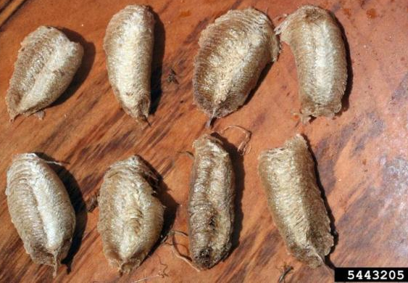
EGG MASS IDENTIFICATION FOR SPOTTED LANTERNFLY
HEMIPTERA: FULGORIDAE: Lycorma delicatula (WHITE)
Mantis egg cases (also known as ootheca) can look similar to the Spotted Lanternfly’s egg mass.
The mantis egg cases are larger and sometimes laid on thin stems, unlike the Spotted Lanternfly’s.
The mass will be more flaky and have elongate cells in them inside.
Whitney Cranshaw, Colorado State University, Bugwood.org

Slide 14
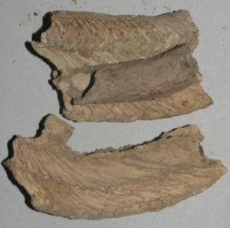
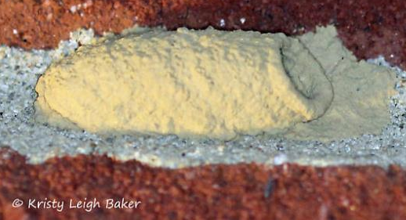
EGG MASS IDENTIFICATION FOR SPOTTED LANTERNFLY
HEMIPTERA: FULGORIDAE: Lycorma delicatula (WHITE)
Mud daubers, potter wasps, and other Hymenoptera can also build structures that may be confused.
Wasp nests are similarly colored, but are made or a durable mud covering and have an open cavity inside.
The cavity will often be provisioned with food for larvae (caterpillars, spiders, and other arthropods).
Bugguide, MJ Hatfield

